Slide 1
Data Engineering – Capstone Project-1

Slide 2
Contents
Business objective
Data used & description
Technology stack used
ER Diagram (data model)
Architecture of pipeline (stages)
Outputs for different analysis (EDA & ML Model)
Challenges you faced

Slide 3
Business Objective
You have been hired as a new data engineer at AnalytixLabs. Your first major task is to work on data engineering project for one of the big corporation’s employees data from the 1980s and 1995s. All the database of employees from that period are provided six CSV files. In this project, you will design data model with all the tables to hold data, import the CSVs into a SQL database, transfer SQL database to HDFS/Hive, and perform analysis using Hive/Impala/Spark/SparkML using the data and create data and ML pipelines.

Slide 4
Data Used & Description
Titles (titles.csv):
title_id – Unique id of type of employee (designation id) – Character – Not Null
title – Designation – Character – Not Null
Employees (employees.csv):
emp_no – Employee Id – Integer – Not Null
emp_titles_id – designation id – Not Null
birth_date – Date of Birth – Date Time – Not Null
first_name – First Name – Character – Not Null
last_name – Last Name – Character – Not Null
sex – Gender – Character – Not Null
hire_date – Employee Hire date –Date Time -Not Null
no_of_projects – Number of projects worked on – Integer – Not Null
Last_performance_rating – Last year performance rating – Character – Not Null
left – Employee left the organization – Boolean – Not Null
Last_date - Last date of employment (Exit Date) – Date Time

Slide 5
Data Used & Description
Salaries (salaries.csv):
emp_no – Employee id – Integer – Not Null
Salary – Employee’s Salary – Integer – Not Null
Departments (departments.csv)
dept_no - Unique id for each department – character – Not Null
dept_name – Department Name – Character – Not Null
Department Managers (dept_manager.csv)
dept_no - Unique id for each department – character – Not Null
emp_no – Employee number (head of the department ) – Integer – Not Null
Department Employees (dept_emp.csv)
emp_no – Employee id – Integer – Not Null
dept_no - Unique id for each department – character – Not Null

Slide 6
Technology stack used
MySQL (to create database)
Linux Commands
Sqoop (Transfer data from MySQL Server to HDFS/Hive)
HDFS (to store the data)
Hive (to create database)
Impala (to perform the EDA)
SparkSQL (to perform the EDA)
SparkML (to perform model building)

Slide 7
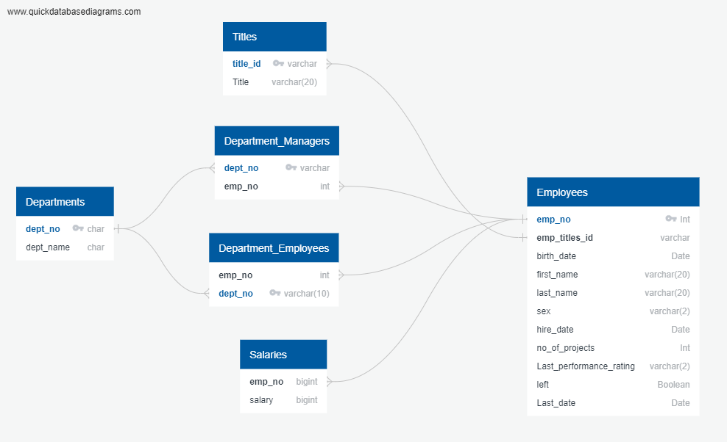
ER Diagram (data model)

Slide 8
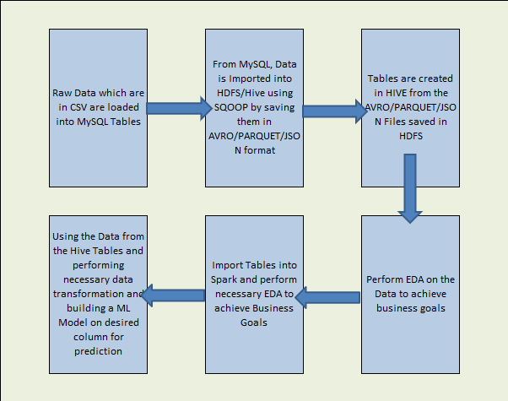
Architecture of pipeline (stages)

Slide 9
Outputs for different analysis (EDA & ML Model)
A List showing employee number, last_name, first name, sex and salary for each employee.
emp_no | last_name | sex | salary
255001 | Panangaden | M | 40000
255002 | Morrey | M | 40000
255003 | Undy | F | 40000
255004 | Coorg | F | 48894
255005 | Otillio | F | 40000
255006 | Heyers | F | 53133
255007 | Radhakrishnan | M | 40000
255008 | Zongker | M | 54753
255009 | Shinomoto | M | 84004

Slide 10
A list showing first name, last_name and hire date for employees who were hired in 1986.
first_name | last_name | hire_date
Zeydy | Hutter | 10/10/1986
Sachar | Guenter | 10/11/1986
Xuedong | Eiter | 11/11/1986
Jinxi | Luef | 10/10/1986
Kyoichi | Domenig | 11/10/1986
Zvonko | Stanfel | 11/11/1986
Mohammad | Vesel | 10/11/1986
Froduald | Danecki | 12/10/1986
Chiradeep | Ciolek | 12/10/1986
Lijie | Schlenzig | 11/11/1986
Jeane | Lammel | 11/12/1986
Ger | Baik | 11/12/1986
Hongzue | Mandell | 12/11/1986
Chinya | Lally | 10/10/1986
Yaghout | Verspoor | 10/11/1986
Goetz | Legleitner | 11/10/1986
Nakhoon | Malabarba | 10/11/1986
Izaskun | Bernick | 11/11/1986
Navin | Strooper | 10/10/1986

Slide 11
A list showing the manager of each department with the following information: department number, department name, the manager's employee number, last name, first name.
dept_no | dept_name | emp_no | last_name | first_name
d001 | "Marketing" | 110039 | Minakawa | Vishwani
d001 | "Marketing" | 110022 | Markovitch | Margareta
d002 | "Finance" | 110114 | Legleitner | Isamu
d002 | "Finance" | 110085 | Alpin | Ebru
d003 | "Human Resources" | 110228 | Sigstam | Karsten
d003 | "Human Resources" | 110183 | Ossenbruggen | Shirish
d004 | "Production" | 110420 | Ghazalie | Oscar
d004 | "Production" | 110386 | Kieras | Shem
d004 | "Production" | 110344 | Cools | Rosine
d004 | "Production" | 110303 | Wegerle | Krassimir
d005 | "development" | 110567 | DasSarma | Leon
d005 | "development" | 110511 | Hagimont | DeForest
d006 | "Quality Management" | 110854 | Pesch | Dung
d006 | "Quality Management" | 110800 | Quadeer | Sanjoy

Slide 12
A list showing first name, last name, and sex of employees whose first name is 'Hercules’ and last name begin with 'B'
first_name | last_name | sex
Hercules | Bernatsky | M
Hercules | Bail | F
Hercules | Birge | F
Hercules | Bisiani | F
Hercules | Bodoff | M
Hercules | Benzmuller | M
Hercules | Brendel | F
Hercules | Baranowski | M
Hercules | Barreiro | M
Hercules | Baer | M
Hercules | Bernardinello | F
Hercules | Basagni | M
Hercules | Biran | F
Hercules | Bahr | M

Slide 13
A list showing all employees in the Sales department, including their employee number, last name, first name, department name.
de.dept_no | e.last_name | e.first_name | d.dept_name
d007 | Simmel | Bezalel | "Sales"
d007 | Cappelletti | Kazuhito | "Sales"
d007 | Swan | Bader | "Sales"
d007 | Lenart | Uri | "Sales"
d007 | Dredge | Yinghua | "Sales"
d007 | Zschoche | Sanjiv | "Sales"
d007 | Billingsley | Breannda | "Sales"
d007 | Herber | Tse | "Sales"
d007 | Brattka | Charlene | "Sales"
d007 | Eugenio | Xinglin | "Sales"
d007 | Syrzycki | Jungsoon | "Sales"
d007 | Flasterstein | Sudharsan | "Sales"
d007 | Desikan | Sailaja | "Sales"
d007 | Morton | Hilari | "Sales"

Slide 14
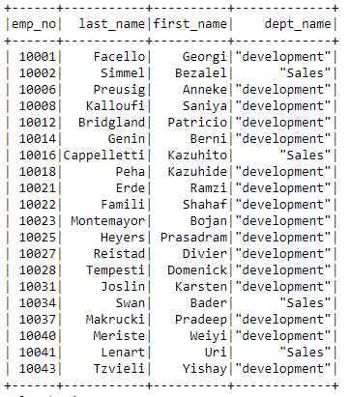
A list showing all employees in the sales and development departments including their employee number, last name, first name and department name.

Slide 15
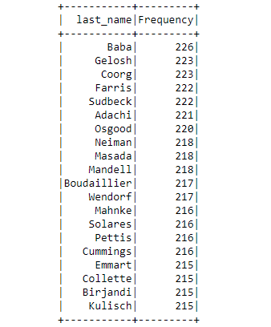
A list showing the frequency count of employee last name, in descending order (i.e., how many employees share each last name)

Slide 16
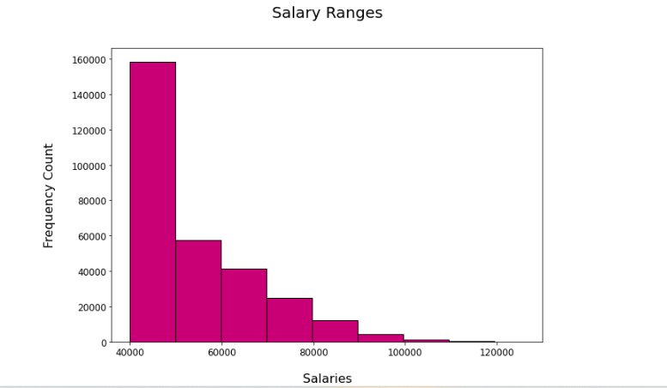
Histogram to show the salary distribution among the employee.

Slide 17
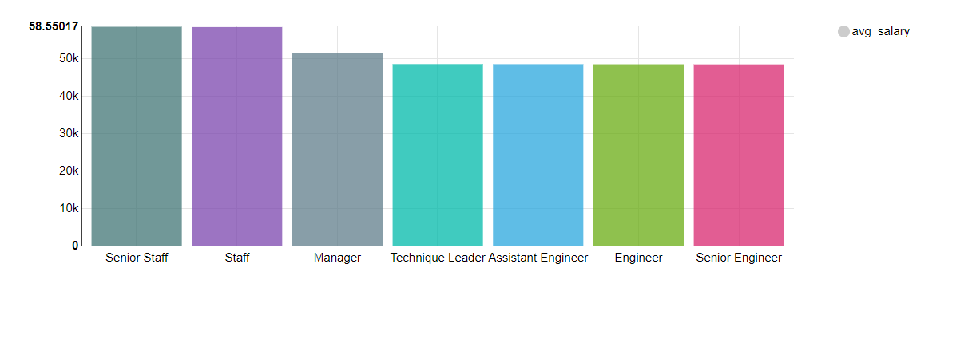
Bar graph to show Avg salary per title (designation)

Slide 18
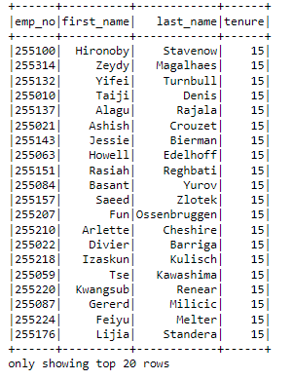
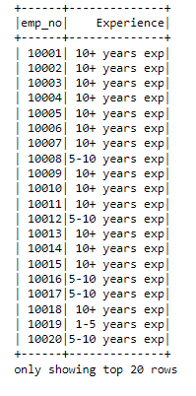
Calculate employee tenure and show tenure distribution among the employees.

Slide 19
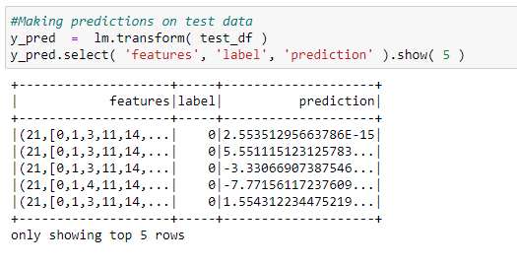
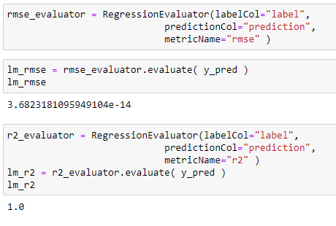
Prediction on test Data and Root-mean-square deviation (RMSE) and R-Squared for Accuracy (goodness of fit)

Slide 20
Challenges you faced
I faced a challenge during the initial stages of the project while loading the data into table which caused error while exporting tables via sqoop.
Another challenge was importing tables via sqoop, since not all tables do not have a primary key assigned, I had to import each table individually.
In Impala after loading the tables into Hive the query which are simple ran without any issues. But queries with complex queries did run since Impala memory got full and had to close and reopen again to run the queries.
In Spark I faced an Issue while importing data from Hive tables. I had to run spark SQL queries to get all columns and save them as Spark Data Frames
In Spark ML and pipeline creation I struggled with the data transformation and what columns to include for model creation and creating a pipeline.

